Slide 1
Chapter 13
Normalization
Transparencies
© Pearson Education Limited 1995, 2005

Slide 2
Chapter 13 - Objectives
The purpose of normalization.
How normalization can be used when designing a relational database.
The potential problems associated with redundant data in base relations.
The concept of functional dependency, which describes the relationship between attributes.
The characteristics of functional dependencies used in normalization.
© Pearson Education Limited 1995, 2005

Slide 3
Chapter 13 - Objectives
How to identify functional dependencies for a given relation.
How functional dependencies identify the primary key for a relation.
How to undertake the process of normalization.
How normalization uses functional dependencies to group attributes into relations that are in a known normal form.
© Pearson Education Limited 1995, 2005

Slide 4
Chapter 13 - Objectives
How to identify the most commonly used normal forms, namely First Normal Form (1NF), Second Normal Form (2NF), and Third Normal Form (3NF).
The problems associated with relations that break the rules of 1NF, 2NF, or 3NF.
How to represent attributes shown on a form as 3NF relations using normalization.
© Pearson Education Limited 1995, 2005

Slide 5
Purpose of Normalization
Normalization
  is a technique for producing a set of suitable relations that support the data requirements of an enterprise.
© Pearson Education Limited 1995, 2005

Slide 6
Purpose of Normalization
Characteristics of a suitable set of relations include:
  the minimal number of attributes necessary to support the data requirements of the enterprise;
  attributes with a close logical relationship are found in the same relation;
  minimal redundancy with each attribute represented only once with the important exception of attributes that form all or part of foreign keys.
© Pearson Education Limited 1995, 2005

Slide 7
Purpose of Normalization
The benefits of using a database that has a suitable set of relations is that the database will be:
  easier for the user to access and maintain the data;
  take up minimal storage space on the computer.
© Pearson Education Limited 1995, 2005

Slide 8
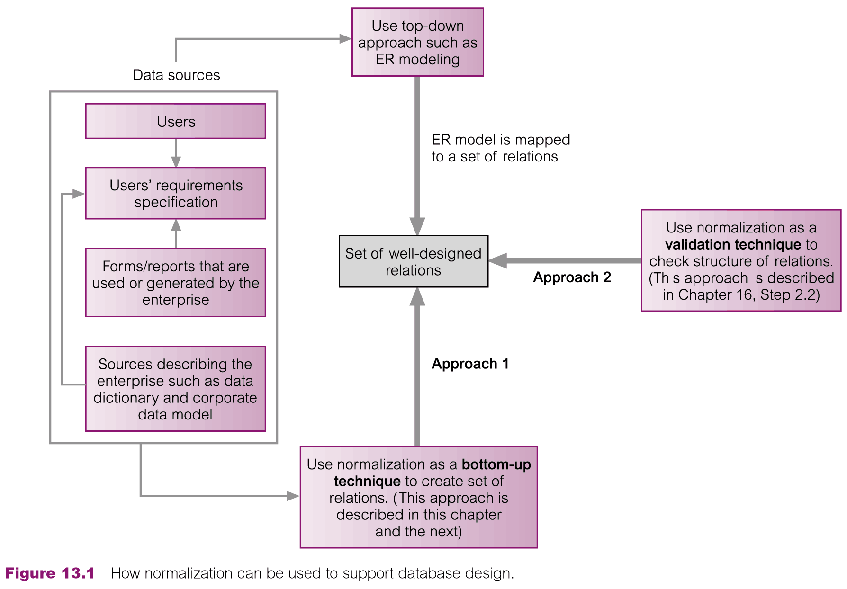
How Normalization Supports Database Design
© Pearson Education Limited 1995, 2005

Slide 9
Data Redundancy and Update Anomalies
Major aim of relational database design is to group attributes into relations to minimize data redundancy.
© Pearson Education Limited 1995, 2005

Slide 10
Data Redundancy and Update Anomalies
Potential benefits for implemented database include:
  Updates to the data stored in the database are achieved with a minimal number of operations thus reducing the opportunities for data inconsistencies.
  Reduction in the file storage space required by the base relations thus minimizing costs.
© Pearson Education Limited 1995, 2005

Slide 11
Data Redundancy and Update Anomalies
Problems associated with data redundancy are illustrated by comparing the Staff and Branch relations with the StaffBranch relation.
© Pearson Education Limited 1995, 2005

Slide 12


Data Redundancy and Update Anomalies
© Pearson Education Limited 1995, 2005

Slide 13
Data Redundancy and Update Anomalies
StaffBranch relation has redundant data; the details of a branch are repeated for every member of staff.
In contrast, the branch information appears only once for each branch in the Branch relation and only the branch number (branchNo) is repeated in the Staff relation, to represent where each member of staff is located.
© Pearson Education Limited 1995, 2005

Slide 14
Data Redundancy and Update Anomalies
Relations that contain redundant information may potentially suffer from update anomalies.
Types of update anomalies include
  Insertion
  Deletion
  Modification
© Pearson Education Limited 1995, 2005

Slide 15
Lossless-join and Dependency Preservation Properties
Two important properties of decomposition.
  Lossless-join property enables us to find any instance of the original relation from corresponding instances in the smaller relations.
  Dependency preservation property enables us to enforce a constraint on the original relation by enforcing some constraint on each of the smaller relations.
© Pearson Education Limited 1995, 2005

Slide 16
Functional Dependencies
Important concept associated with normalization.
Functional dependency describes relationship between attributes.
For example
if A and B are attributes of relation R, B is functionally dependent on A (denoted A → B), if each value of A in R is associated with exactly one value of B in R.
© Pearson Education Limited 1995, 2005

Slide 17
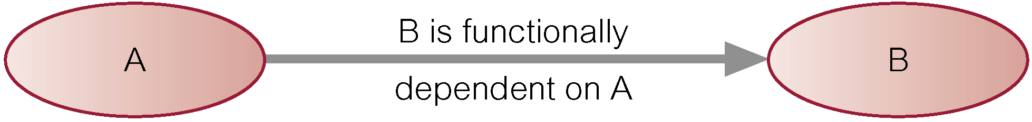
Characteristics of Functional Dependencies
Property of the meaning or semantics of the attributes in a relation.
Diagrammatic representation.
The determinant of a functional dependency refers to the attribute or group of attributes on the left-hand side of the arrow.
© Pearson Education Limited 1995, 2005

Slide 18
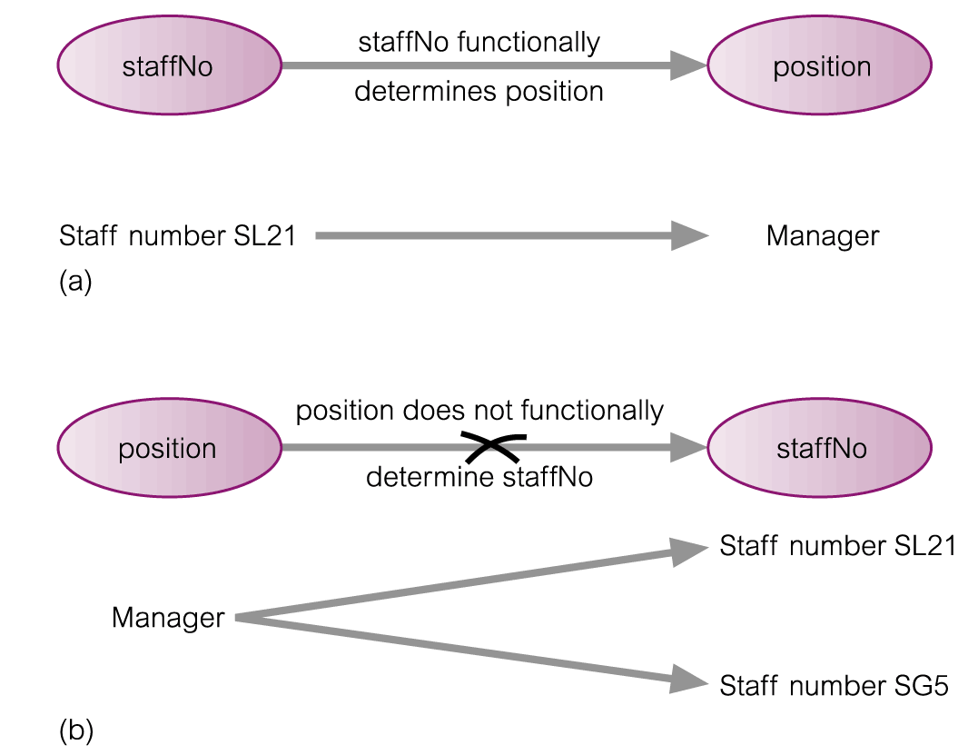
An Example Functional Dependency
© Pearson Education Limited 1995, 2005

Slide 19
Example Functional Dependency that holds for all Time
Consider the values shown in staffNo and sName attributes of the Staff relation (figure below).
Based on sample data, the following functional dependencies appear to hold.
  staffNo → sName
  sName → staffNo
© Pearson Education Limited 1995, 2005

Slide 20
Example Functional Dependency that holds for all Time
However, the only functional dependency that remains true for all possible values for the staffNo and sName attributes of the Staff relation is:
  staffNo → sName
© Pearson Education Limited 1995, 2005

Slide 21
Characteristics of Functional Dependencies
Determinants should have the minimal number of attributes necessary to maintain the functional dependency with the attribute(s) on the right hand-side.
This requirement is called full functional dependency.
© Pearson Education Limited 1995, 2005

Slide 22
Characteristics of Functional Dependencies
Full functional dependency indicates that if A and B are attributes of a relation, B is fully functionally dependent on A, if B is functionally dependent on A, but not on any proper subset of A.
© Pearson Education Limited 1995, 2005

Slide 23
Example Full Functional Dependency
staffNo, sName → branchNo
True - each value of (staffNo, sName) is associated with a single value of branchNo.
However, branchNo is also functionally dependent on a subset of (staffNo, sName), namely staffNo. Example above is a partial dependency.
© Pearson Education Limited 1995, 2005

Slide 24
Characteristics of Functional Dependencies
Main characteristics of functional dependencies used in normalization:
  There is a one-to-one relationship between the attribute(s) on the left-hand side (determinant) and those on the right-hand side of a functional dependency.
  Holds for all time.
  The determinant has the minimal number of attributes necessary to maintain the dependency with the attribute(s) on the right hand-side.
© Pearson Education Limited 1995, 2005

Slide 25
Transitive Dependencies
Important to recognize a transitive dependency because its existence in a relation can potentially cause update anomalies.
Transitive dependency describes a condition where A, B, and C are attributes of a relation such that:
if A → B and B → C, then C is transitively dependent on A via B (provided that A is not functionally dependent on B or C).
© Pearson Education Limited 1995, 2005

Slide 26
Example Transitive Dependency
Consider functional dependencies in the StaffBranch relation (see Slide 12).
staffNo → sName, position, salary, branchNo, bAddress
branchNo → bAddress
Transitive dependency, branchNo → bAddress exists on staffNo via branchNo.
© Pearson Education Limited 1995, 2005

Slide 27
The Process of Normalization
Formal technique for analyzing a relation based on its primary key and the functional dependencies between the attributes of that relation.
Often executed as a series of steps. Each step corresponds to a specific normal form, which has known properties.
© Pearson Education Limited 1995, 2005

Slide 28
Identifying Functional Dependencies
Identifying all functional dependencies between a set of attributes is relatively simple if the meaning of each attribute and the relationships between the attributes are well understood.
This information should be provided by the enterprise in the form of discussions with users and/or documentation such as the users’ requirements specification.
© Pearson Education Limited 1995, 2005

Slide 29
Identifying Functional Dependencies
However, if the users are unavailable for consultation and/or the documentation is incomplete then depending on the database application it may be necessary for the database designer to use their common sense and/or experience to provide the missing information.
© Pearson Education Limited 1995, 2005

Slide 30
Example - Identifying a set of functional dependencies for the StaffBranch relation
Examine semantics of attributes in StaffBranch relation
Assume that position held and branch determine a member of staff’s salary.
© Pearson Education Limited 1995, 2005

Slide 31
Example - Identifying a set of functional dependencies for the StaffBranch relation
With sufficient information available, identify the functional dependencies for the StaffBranch relation as:
1. staffNo → sName, position, salary, branchNo, bAddress
2. branchNo → bAddress
3. bAddress → branchNo
4. branchNo, position → salary
5. bAddress, position → salary
© Pearson Education Limited 1995, 2005

Slide 32
Example - Using sample data to identify functional dependencies.
Consider the data for attributes denoted A, B, C, D, and E in the Sample relation (see Slide 33).
Important to establish that sample data values shown in relation are representative of all possible values that can be held by attributes A, B, C, D, and E. Assume true despite the relatively small amount of data shown in this relation.
© Pearson Education Limited 1995, 2005

Slide 33
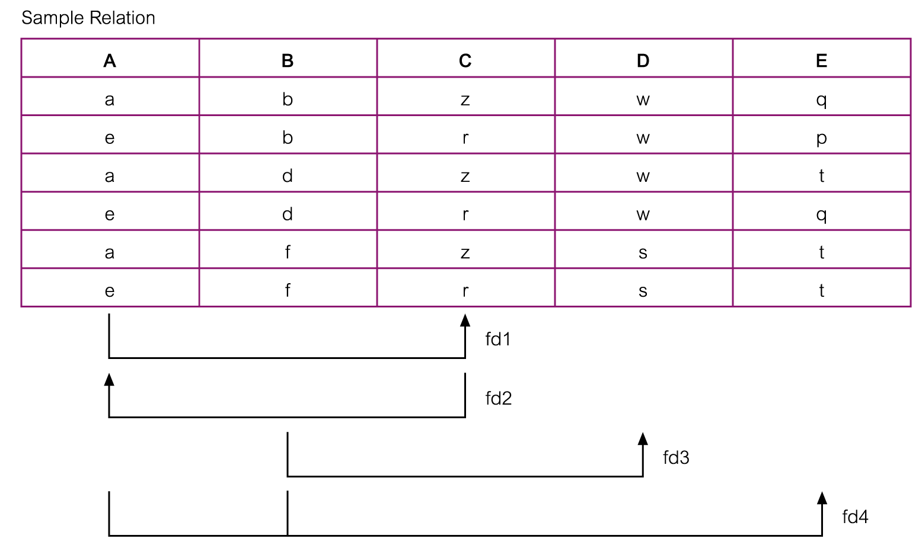
Example - Using sample data to identify functional dependencies.
© Pearson Education Limited 1995, 2005

Slide 34
Example - Using sample data to identify functional dependencies.
Function dependencies between attributes A to E in the Sample relation.
A → C (fd1)
C → A (fd2)
B → D (fd3)
A, B → E (fd4)
© Pearson Education Limited 1995, 2005

Slide 35
Identifying the Primary Key for a Relation using Functional Dependencies
Main purpose of identifying a set of functional dependencies for a relation is to specify the set of integrity constraints that must hold on a relation.
An important integrity constraint to consider first is the identification of candidate keys, one of which is selected to be the primary key for the relation.
© Pearson Education Limited 1995, 2005

Slide 36
Example - Identify Primary Key for StaffBranch Relation
StaffBranch relation has five functional dependencies (see Slide 31).
staffNo → sName, position, salary, branchNo, bAddress
The determinants are staffNo, branchNo, bAddress, (branchNo, position), and (bAddress, position).
To identify all candidate key(s), identify the attribute (or group of attributes) that uniquely identifies each tuple in this relation.
© Pearson Education Limited 1995, 2005

Slide 37
Example - Identifying Primary Key for StaffBranch Relation
All attributes that are not part of a candidate key should be functionally dependent on the key.
The only candidate key and therefore primary key for StaffBranch relation, is staffNo, as all other attributes of the relation are functionally dependent on staffNo.
© Pearson Education Limited 1995, 2005

Slide 38
Example - Identifying Primary Key for Sample Relation
Sample relation has four functional dependencies (see Slide 31).
staffNo → sName, position, salary, branchNo, bAddress
The determinants in the Sample relation are A, B, C, and (A, B). However, the only determinant that functionally determines all the other attributes of the relation is (A, B).
(A, B) is identified as the primary key for this relation.
© Pearson Education Limited 1995, 2005

Slide 39
The Process of Normalization
As normalization proceeds, the relations become progressively more restricted (stronger) in format and also less vulnerable to update anomalies.
© Pearson Education Limited 1995, 2005

Slide 40
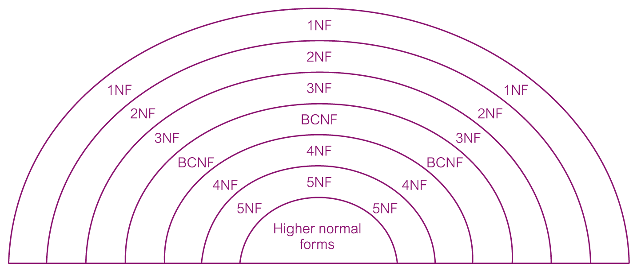
The Process of Normalization
© Pearson Education Limited 1995, 2005

Slide 41
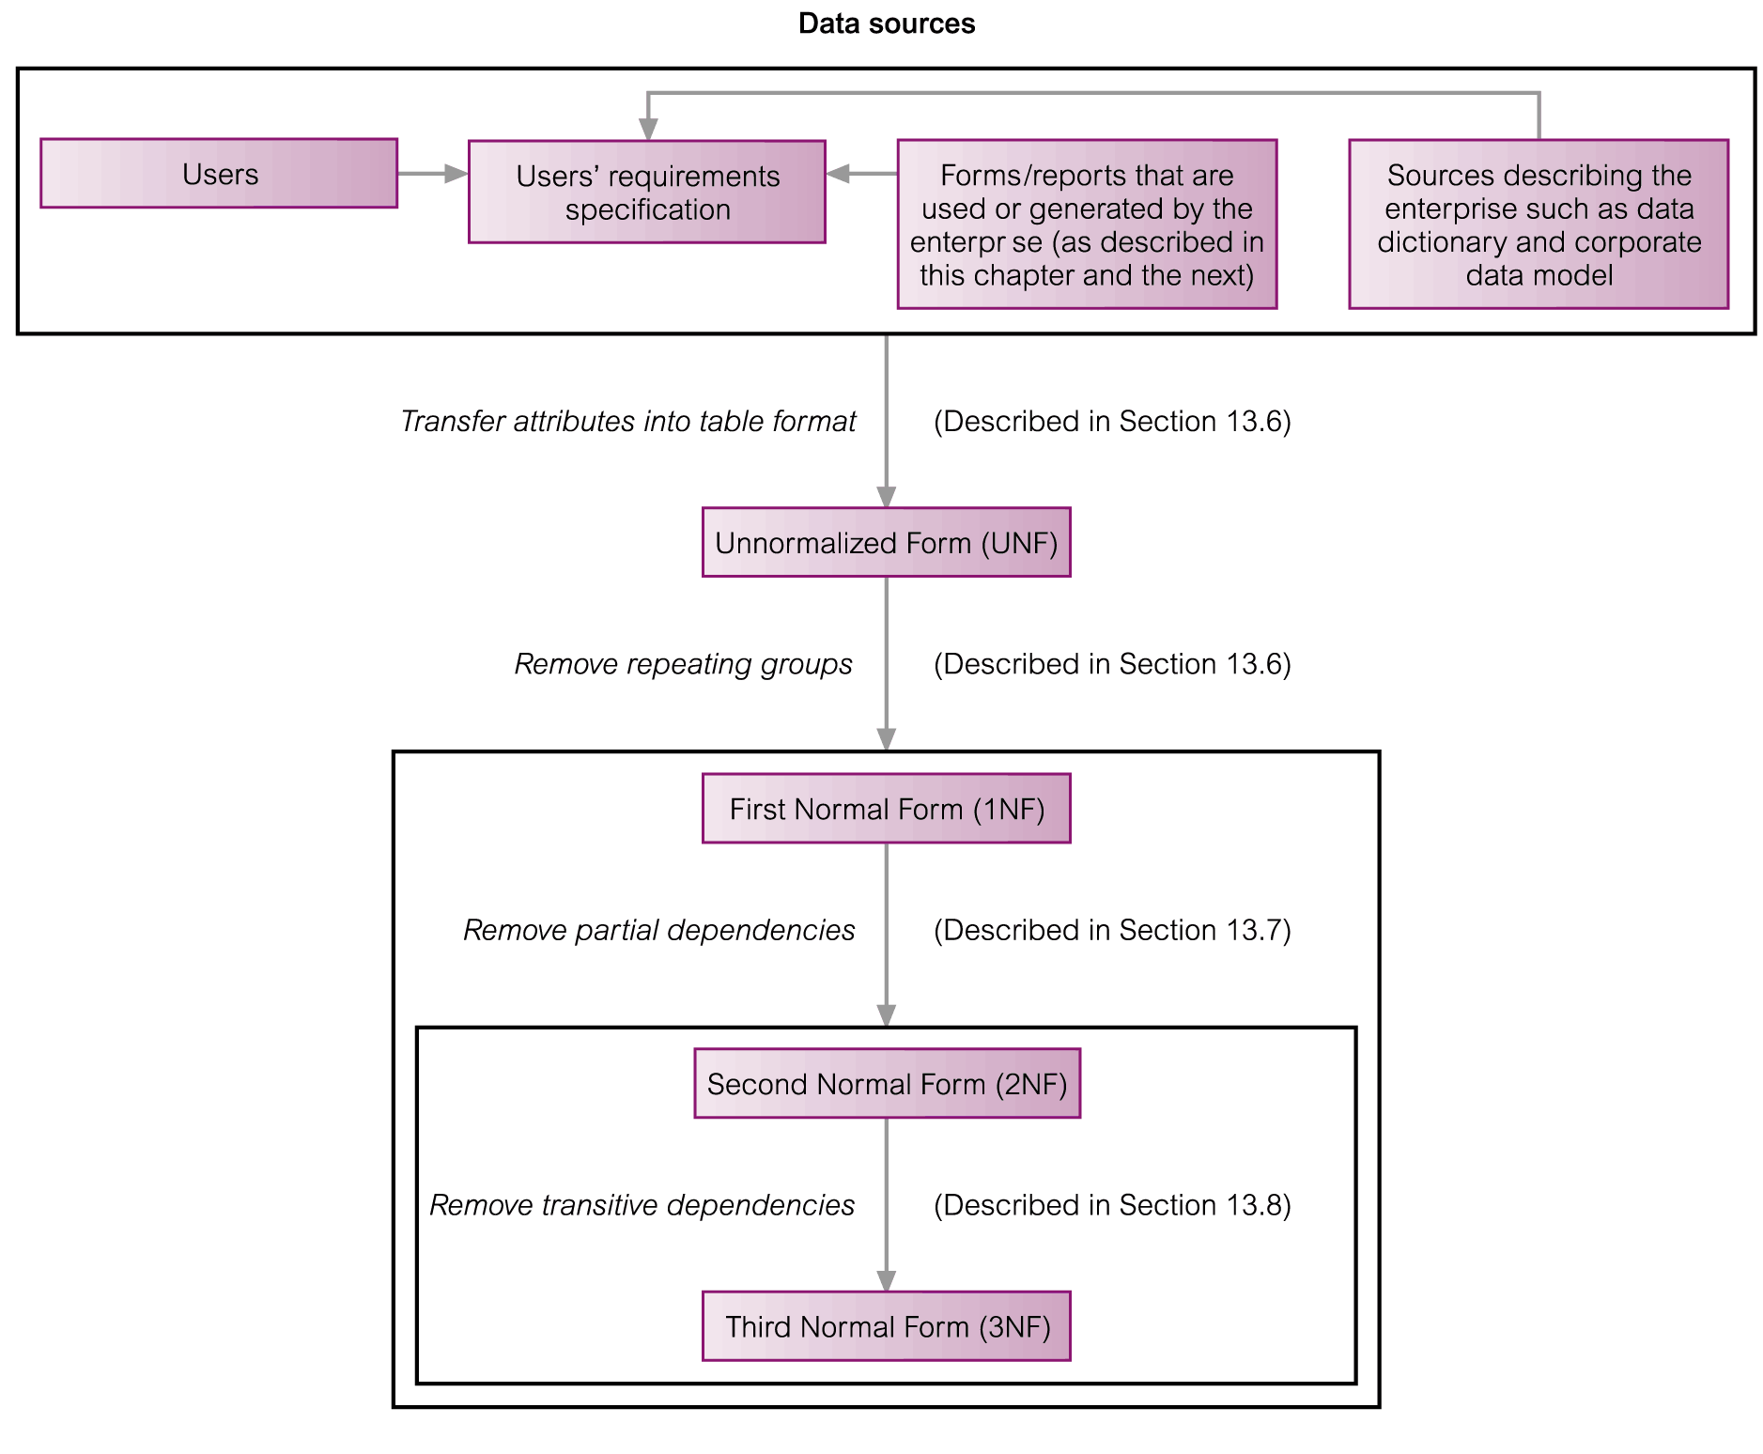
The Process of Normalization
© Pearson Education Limited 1995, 2005

Slide 42
Unnormalized Form (UNF)
A table that contains one or more repeating groups.
To create an unnormalized table
  Transform the data from the information source (e.g. form) into table format with columns and rows.
© Pearson Education Limited 1995, 2005

Slide 43
First Normal Form (1NF)
A relation in which the intersection of each row and column contains one and only one value.
© Pearson Education Limited 1995, 2005

Slide 44
UNF to 1NF
Nominate an attribute or group of attributes to act as the key for the unnormalized table.
Identify the repeating group(s) in the unnormalized table which repeats for the key attribute(s).
© Pearson Education Limited 1995, 2005

Slide 45
UNF to 1NF
Remove the repeating group by
  Entering appropriate data into the empty columns of rows containing the repeating data (‘flattening’ the table).
  Or by
  Placing the repeating data along with a copy of the original key attribute(s) into a separate relation.
© Pearson Education Limited 1995, 2005

Slide 46
Second Normal Form (2NF)
Based on the concept of full functional dependency.
Full functional dependency indicates that if
  A and B are attributes of a relation,
  B is fully dependent on A if B is functionally dependent on A but not on any proper subset of A.
© Pearson Education Limited 1995, 2005

Slide 47
Second Normal Form (2NF)
A relation that is in 1NF and every non-primary-key attribute is fully functionally dependent on the primary key.
© Pearson Education Limited 1995, 2005

Slide 48
1NF to 2NF
Identify the primary key for the 1NF relation.
Identify the functional dependencies in the relation.
If partial dependencies exist on the primary key remove them by placing then in a new relation along with a copy of their determinant.
© Pearson Education Limited 1995, 2005

Slide 49
Third Normal Form (3NF)
Based on the concept of transitive dependency.
Transitive Dependency is a condition where
  A, B and C are attributes of a relation such that if A → B and B → C,
  then C is transitively dependent on A through B. (Provided that A is not functionally dependent on B or C).
© Pearson Education Limited 1995, 2005

Slide 50
Third Normal Form (3NF)
A relation that is in 1NF and 2NF and in which no non-primary-key attribute is transitively dependent on the primary key.
© Pearson Education Limited 1995, 2005

Slide 51
2NF to 3NF
Identify the primary key in the 2NF relation.
Identify functional dependencies in the relation.
If transitive dependencies exist on the primary key remove them by placing them in a new relation along with a copy of their dominant.
© Pearson Education Limited 1995, 2005

Slide 52
General Definitions of 2NF and 3NF
Second normal form (2NF)
  A relation that is in first normal form and every non-primary-key attribute is fully functionally dependent on any candidate key.
Third normal form (3NF)
  A relation that is in first and second normal form and in which no non-primary-key attribute is transitively dependent on any candidate key.
© Pearson Education Limited 1995, 2005

Slide 53
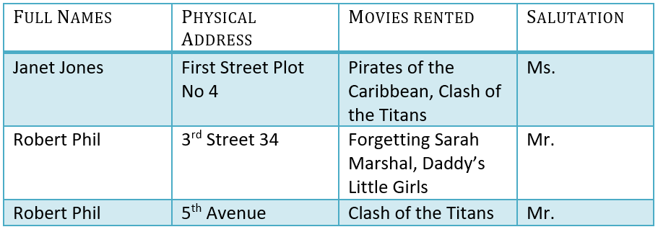
Example

Slide 54
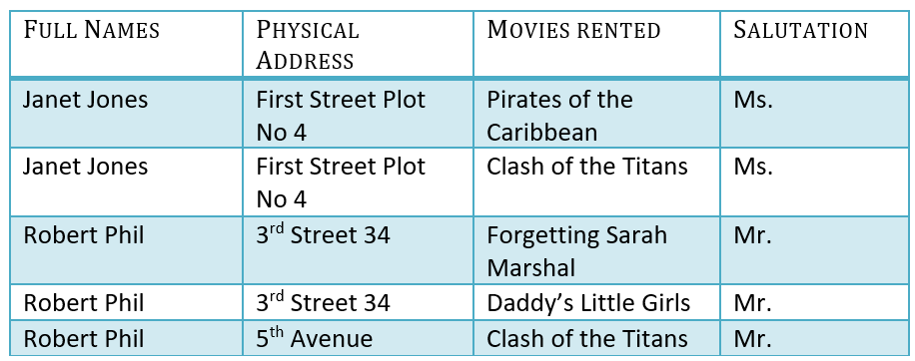
1NF (First Normal Form) Rules
Each table cell should contain a single value.
Each record needs to be unique.
The above table in 1NF-

Slide 55
2NF (Second Normal Form) Rules
Rule 1- Be in 1NF
Rule 2- Single Column Primary Key
It is clear that we can't move forward to make our simple database in 2nd Normalization form unless we partition the table above.

Slide 56



Slide 57
2NF
We have divided our 1NF table into two tables viz. Table 1 and Table2. Table 1 contains member information. Table 2 contains information on movies rented.
We have introduced a new column called Membership_id which is the primary key for table 1. Records can be uniquely identified in Table 1 using membership id

Slide 58
3NF (Third Normal Form) Rules
Rule 1- Be in 2NF
Rule 2- Has no transitive functional dependencies

Slide 59
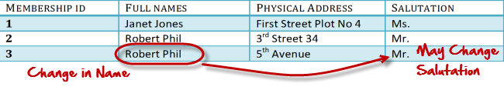
transitive dependencies
A transitive dependency is when changing a non-key column, might cause any of the other non-key columns to change
Consider the table below, changing the non-key column Full Name may change Salutation.

Slide 60

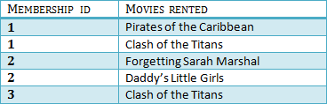

To move our 2NF table into 3NF, we again need to again divide our table.

Slide 61
3-NF
We have again divided our tables and created a new table which stores Salutations.
There are no transitive functional dependencies, and hence our table is in 3NF
In Table 3 Salutation ID is primary key, and in Table 1 Salutation ID is foreign to primary key in Table 3

Slide 62
BCNF (Boyce-Codd Normal Form)
Even when a database is in 3rd Normal Form, still there would be anomalies resulted if it has more than one Candidate Key.
Sometimes is BCNF is also referred as 3.5 Normal Form.

Slide 63
Normalization
Database designing is critical to the successful implementation of a database management system that meets the data requirements of an enterprise system.
Normalization Process in DBMS helps produce database systems that are cost-effective and have better security models.
Functional dependencies are a very important component of the normalize data process
Most database systems are normalized database up to the third normal forms.
A primary key uniquely identifies are record in a Table and cannot be null
A foreign key helps connect table and references a primary key

